Slide 1
PowerShare (WIP)
-Ty Yiu

Slide 2
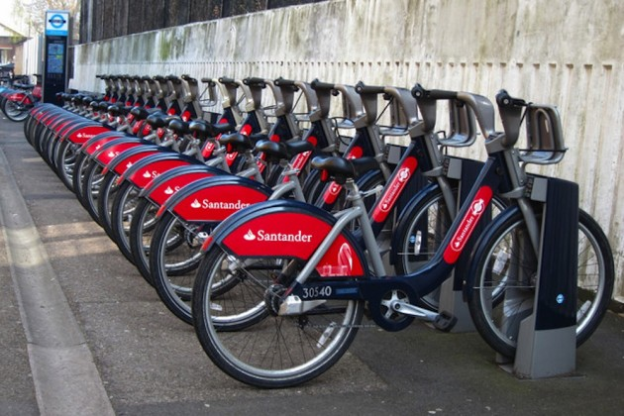
http://www.cyclingweekly.com/news/latest-news/new-app-launched-by-tfl-to-make-hiring-a-boris-bike-easier-170649

Slide 3
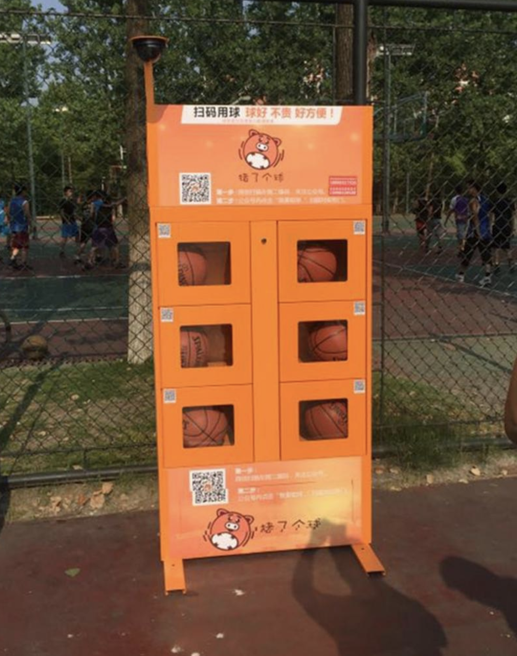
https://www.forbes.com/sites/ywang/2017/05/31/sharing-is-caring-chinas-smartphone-share-economy-is-booming/#9a480222b078

Slide 4

https://www.mumbrella.asia/2017/09/uber-sues-dentsu-agency-allegations-fraud-negligence

Slide 5

https://airbnbreview.com/airbnb-competitors-alternatives

Slide 6
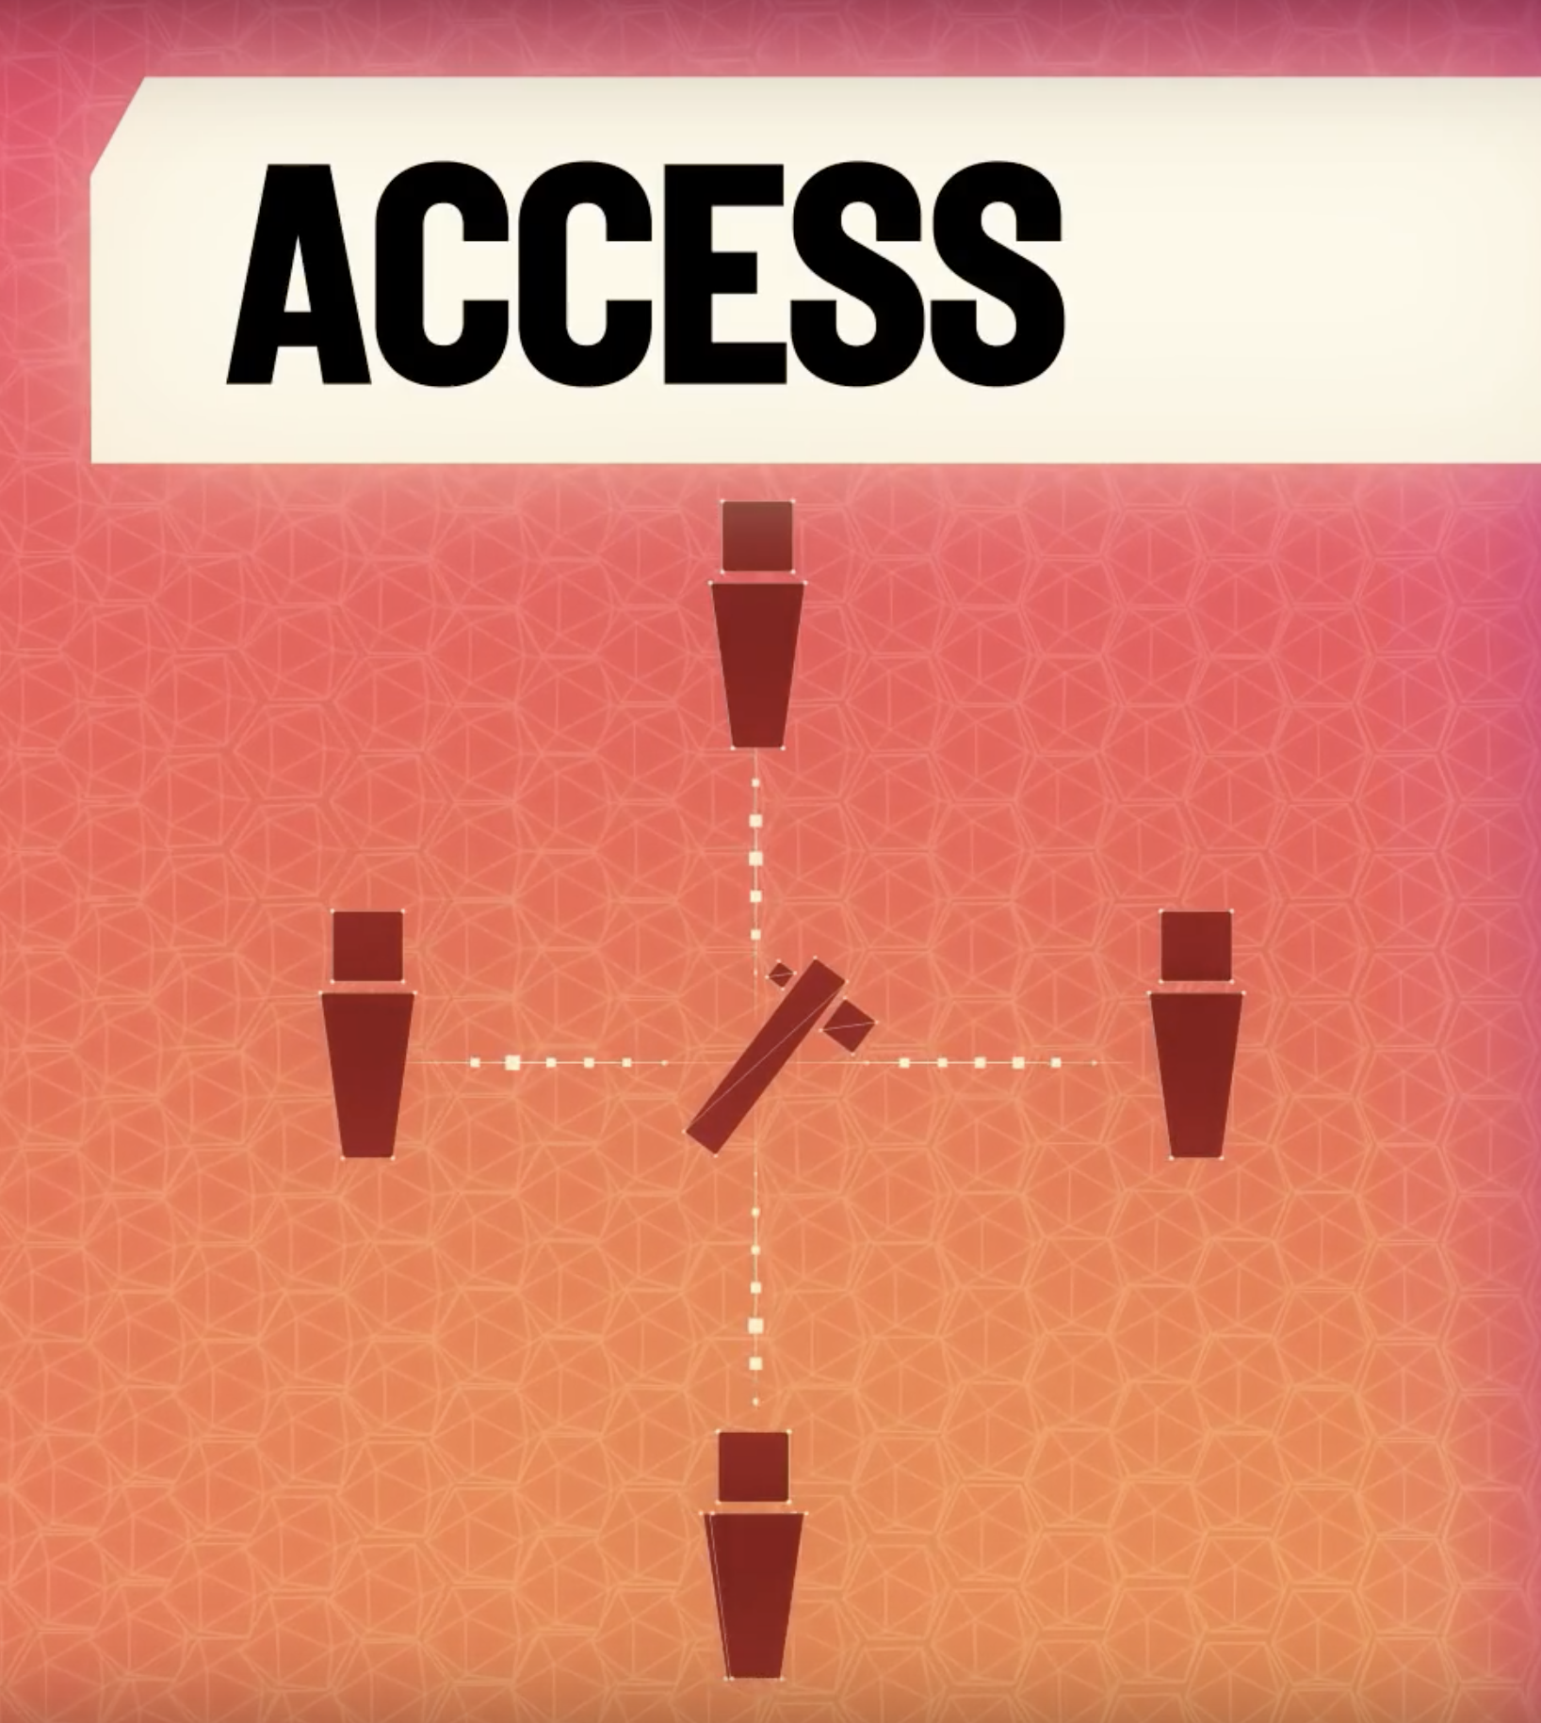
https://www.theverge.com/a/verge-2021/google-x-astro-teller-interview-drones-innovation

Slide 7
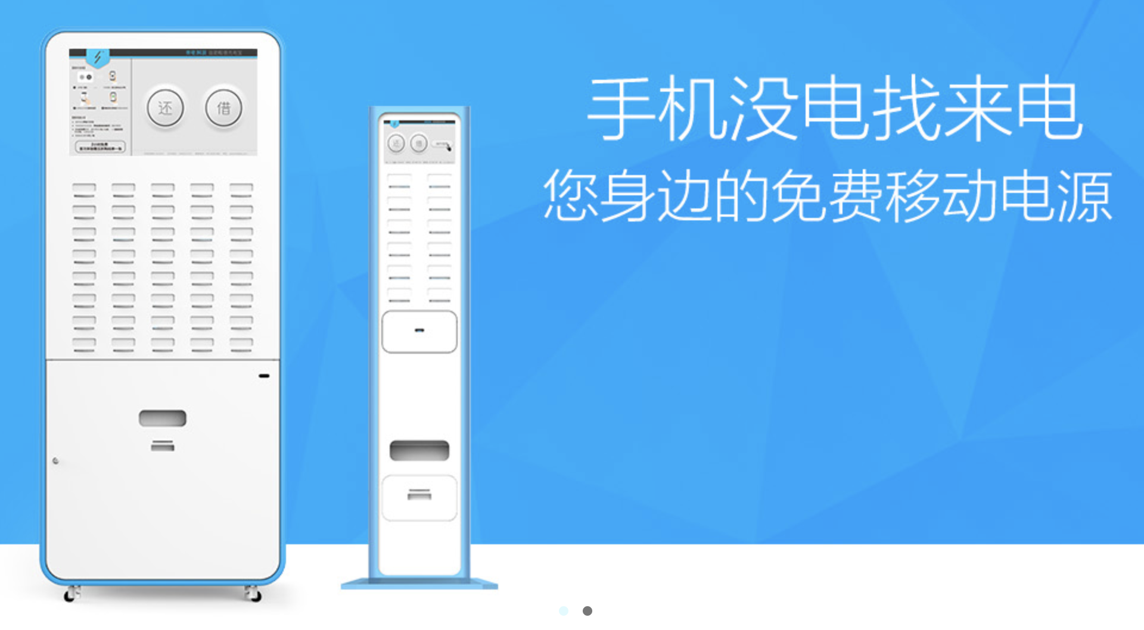
http://www.imlaidian.com/

Slide 8
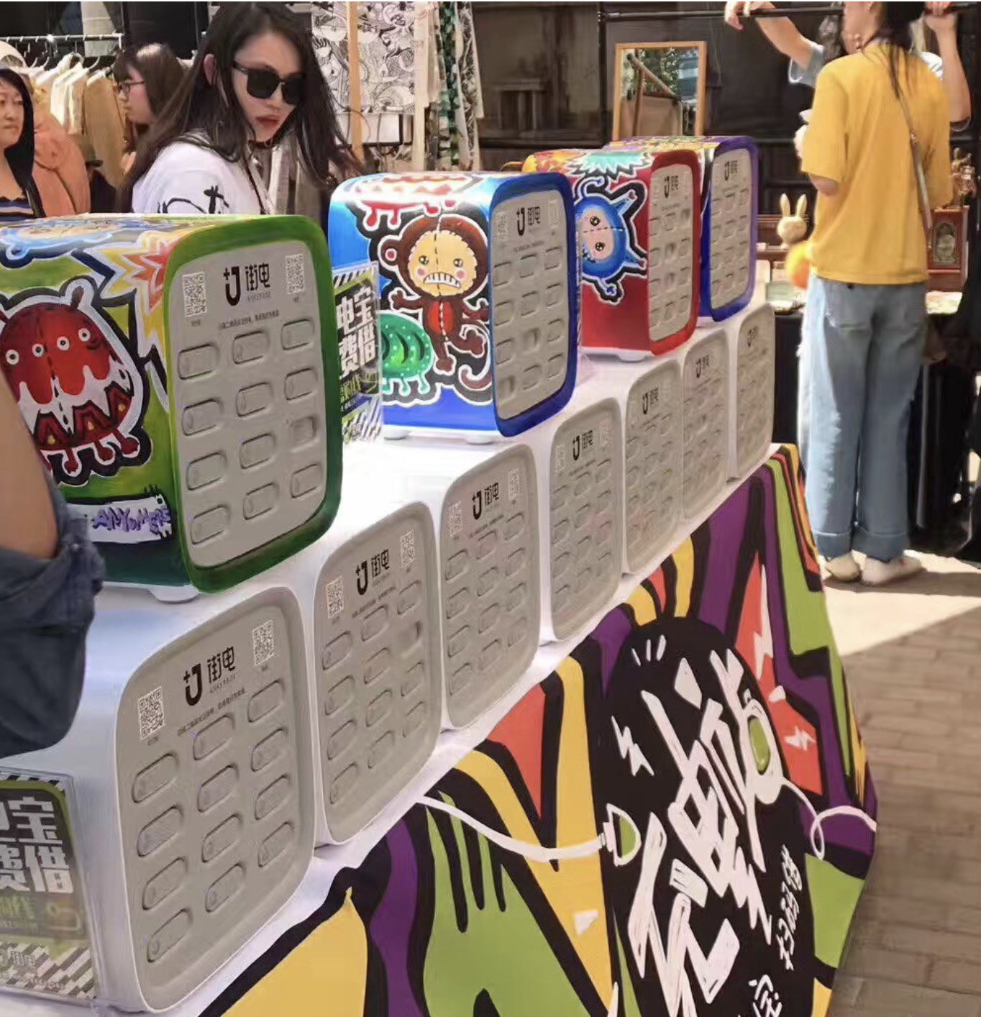
https://medium.com/act-news/ankerbox-aims-to-cash-in-on-chinas-latest-power-bank-rental-hype-8c1ae9c2b94

Slide 9
Some Numbers
placed more than 100,000 power banks in 20 Chinese cities.
more than RMB 300 million (USD 44 million) financing in just 10 days
visited its 3,000 charging stations more than 100 million times
Approximately 15 cents to rent a power bank for an hour.
Averages and specific information

Slide 10
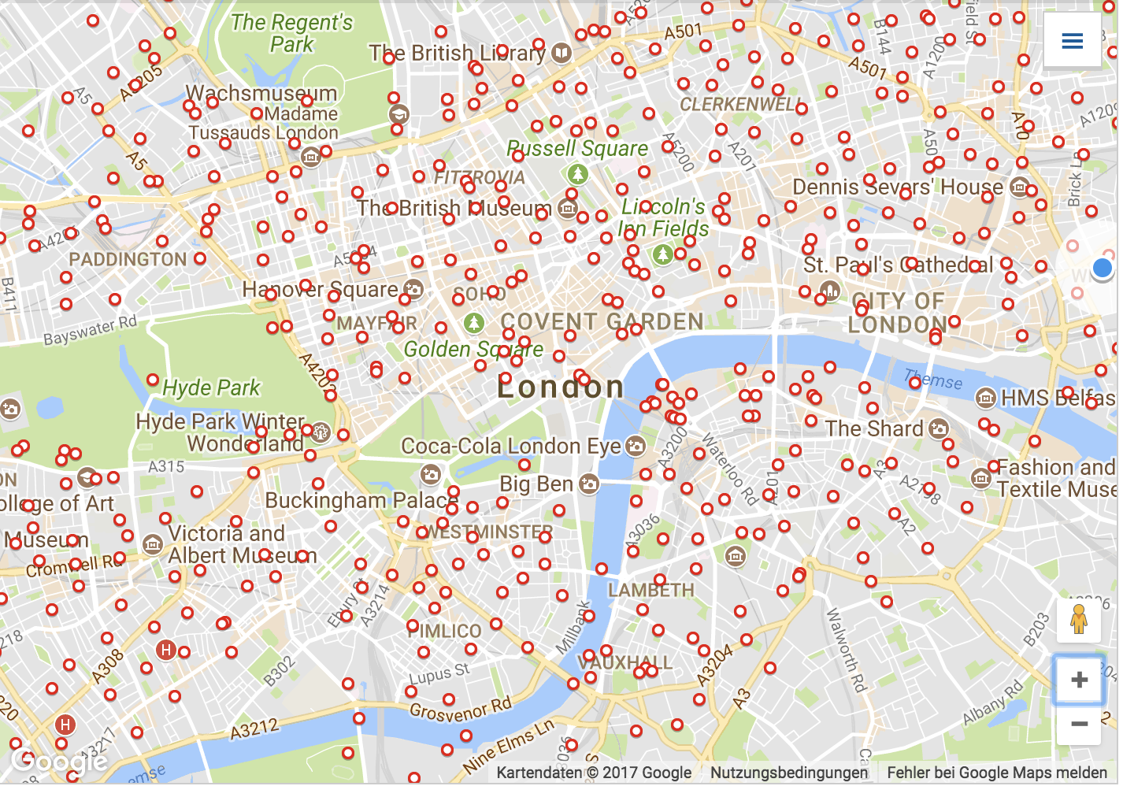
https://tfl.gov.uk/modes/cycling/santander-cycles/find-a-docking-station?intcmp=2321

Slide 11
What´s needed?
Constructive & destructive feedback
Money for acceleration
Expertise and mentorship
Brainpower for problem-solving (Potential Partner?)

Slide 12
What´s not needed?
An App, Website…
Intangibles will be developed in-house

Slide 13
Beta Test
To receive resonance and feedback from the market
Using no or approximated functions of planned station
Using non-custom, generic batteries
Monitored usage
Location e.g. campus of different universities, Shopping malls etc.

Slide 14
Some more numbers
Price of custom battery housing ca. 3000 Euros
Average 2000mah battery price ca. 3 Euros a piece (PPP,PVC)
R&D costs for station estimated at 2000 Pounds
Where final station cost p.U. is estimated at 80-150 Pounds
Beta Test costs estimated at 3000 Pounds

Slide 15
Timeline
First Fund Raise
Beta Test
Big Scale Fund Raise
Within End November
Within End December 2017
Start Producing
Start For Public
Finish R&D
Until March 2018
Until End June 2018

